Slide 2
Top
about
food
festival
dress
About

Slide 3
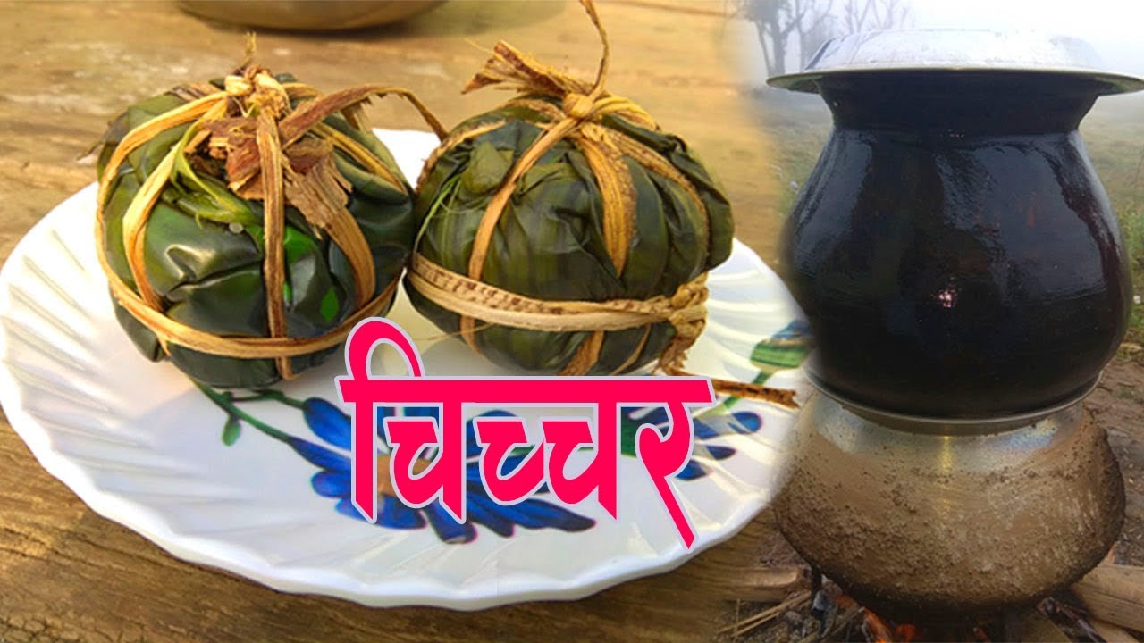
top
about
food
festival
dress
food

Slide 4
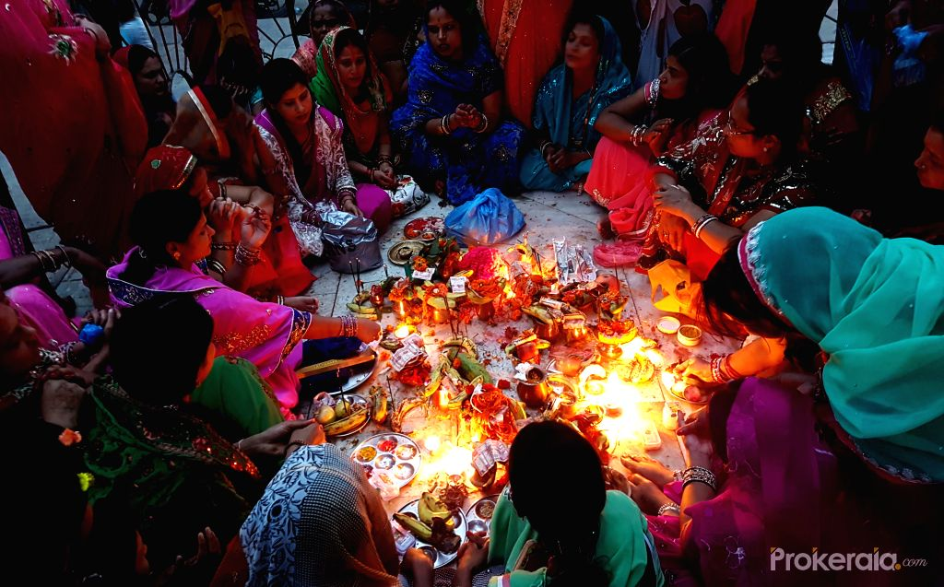
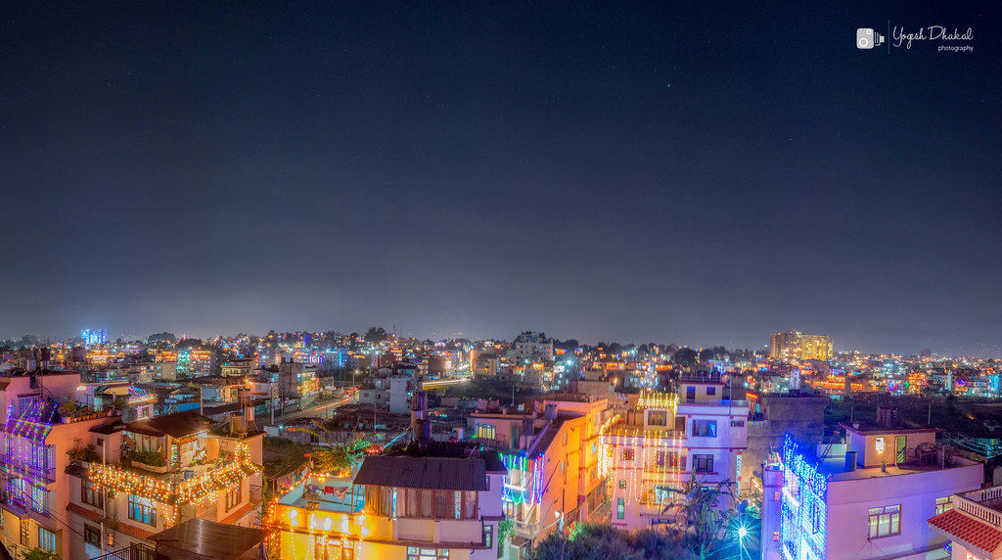
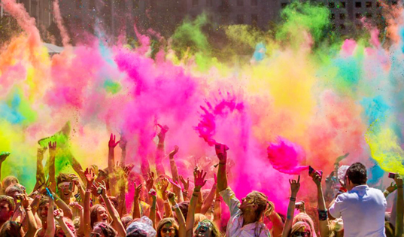
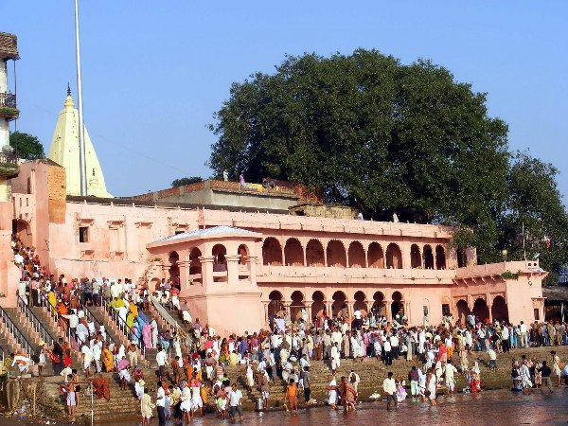
Tharu culture
top
about
food
festival
dress
festival
Jitiya is celebrated by tharu women for 3 days.jitiya is a symbol of victory.they take fasting for the good of their family and children.
tihar
Jitiya

